Slide 1
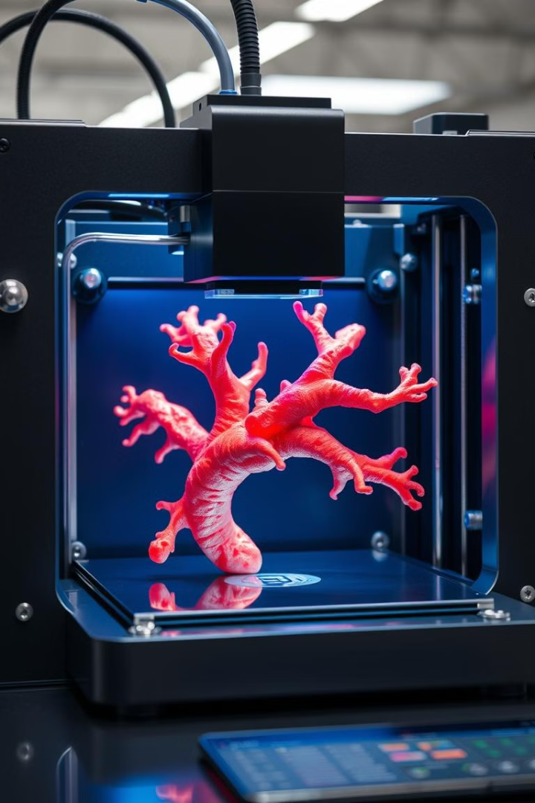
Bioinks for 3D Bioprinting: Revolutionizing Tissue Engineering
Bioinks are emerging as a key technology for tissue engineering. They offer potential for regenerating damaged tissues. This interdisciplinary field combines materials science, cell biology, and engineering.

Slide 2
What Are Bioinks?
Specialized Materials
Natural and Synthetic
Functional Tissues
Bioinks are specialized materials for 3D bioprinting. They contain biomaterials, living cells, and growth factors.
These inks are typically composed of natural or synthetic polymers. They enable the precise placement of biological materials.
The goal is to create functional tissue constructs. These constructs should match native tissues in structure and function.

Slide 3
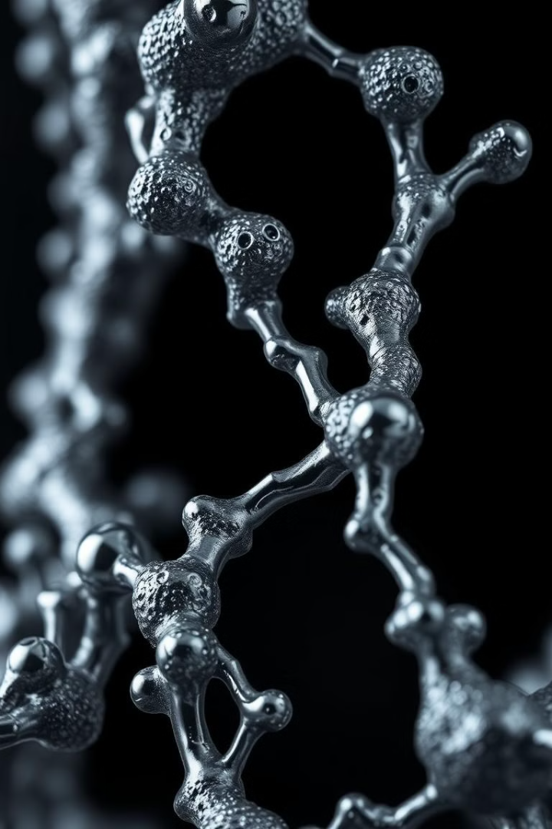
Types of Bioink Materials
Natural Polymers
Synthetic Polymers
Collagen
PEG
Alginate
Pluronic
Gelatin
PCL
Fibrin
Hybrid Materials
Combine natural and synthetic components for tailored properties.

Slide 4
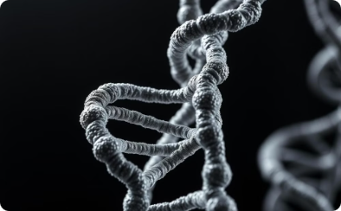
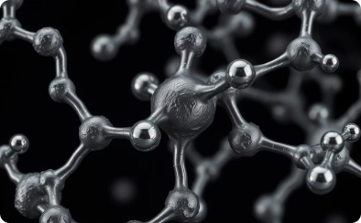
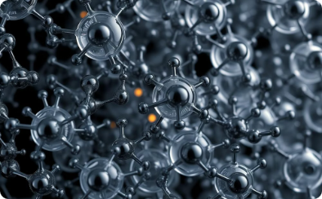
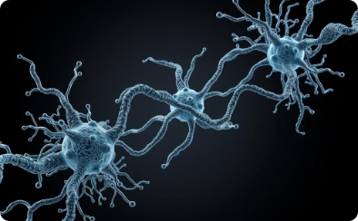
Exploring Natural Polymers in Bioink Development
Collagen
Alginate
Gelatin
Fibrin
Derived from natural sources, collagen offers excellent biocompatibility for tissue engineering applications.
Known for its versatility, alginate is commonly used in bioink formulations for its gelation properties.
Derived from collagen, gelatin serves as a biocompatible and biodegradable material in bioink development.
With its ability to mimic the natural blood clotting process, fibrin is a key component in bioinks for wound healing applications.

Slide 5
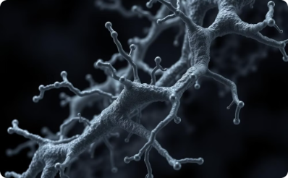
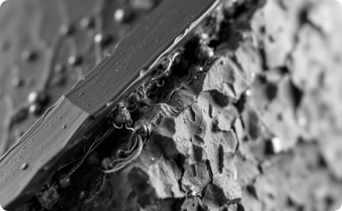
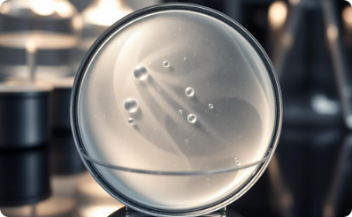
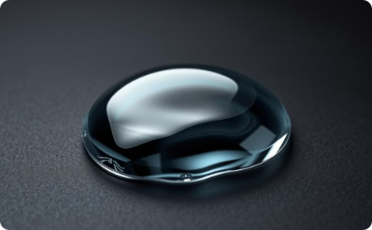
Optimizing Natural Polymers for Bioink Formulations
Visualizing key natural polymers and their properties for bioink development.
Collagen
dECM
Alginate
Gelatin
High printability at concentrations >10 mg/mL. Lower transparency at concentration >40 mg/mL. Support bath needed for lower concentrations.
Higher transparency than collagen (~75% in visible spectrum). Poor printability due to mechanical properties and low viscosity. Support bath needed.
~88.13% transparency. Crosslinking mechanism is not suitable for direct extrusion printing.
Transparency varies with GelMA concentration. High printability at concentration > 6% w/v.

Slide 6
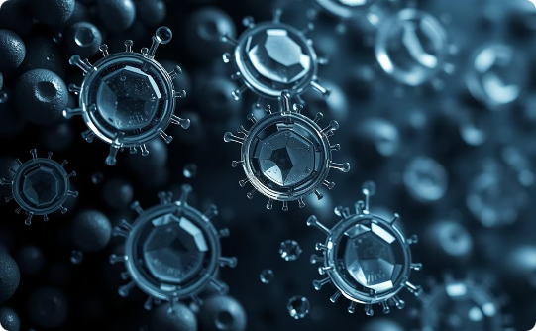
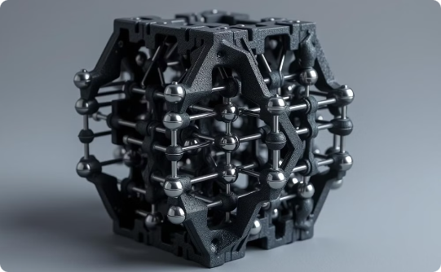
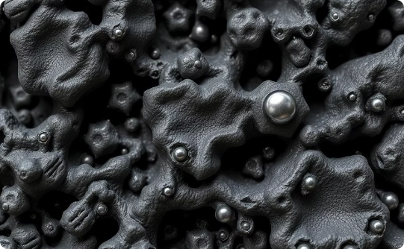
Key Challenges in Bioink Development
Cell Viability
Mechanical Properties
Balancing Act
Ensuring cells survive the 3D printing process.
Creating structures with the right strength and flexibility.
Maintaining printability, shape, and biological function.

Slide 7
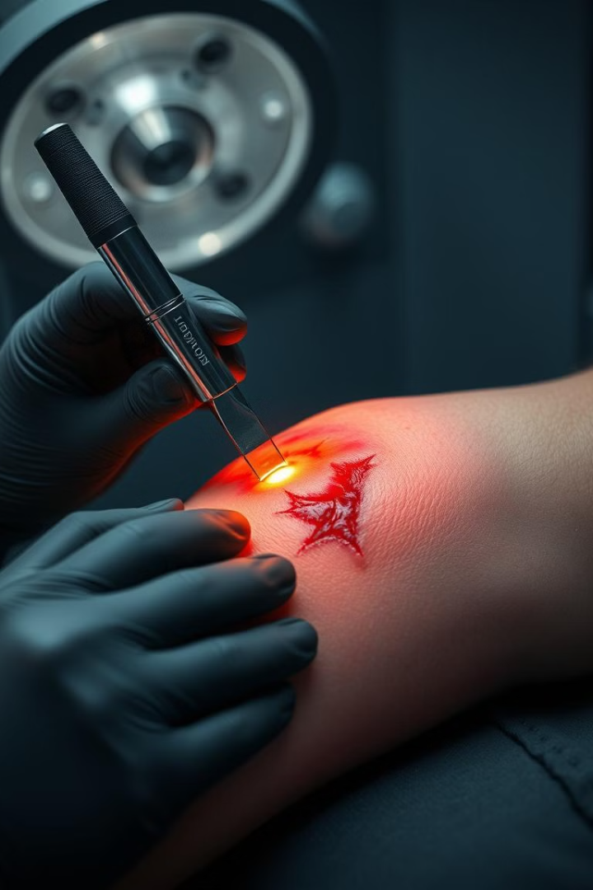
Emerging Applications
Tissue Regeneration
Skin grafts, bone reconstruction, and neural tissue repair.
Drug Screening
Testing drug efficacy and toxicity on 3D tissues.
Personalized Medicine
Creating patient-specific tissue and organ models.

Slide 8
Future Innovations
4D Bioprinting
Machine Learning
Multi-Material Printing

Slide 9
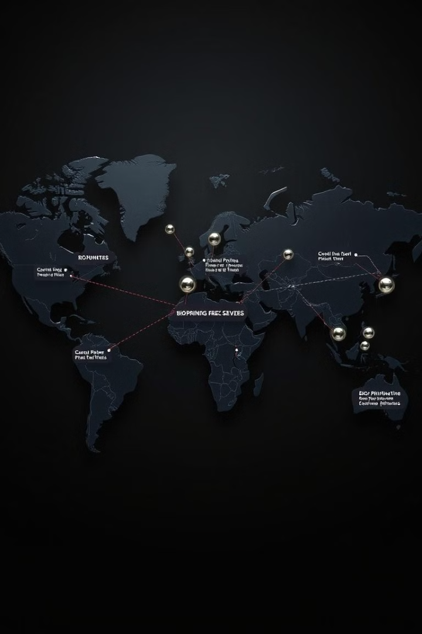
The Future of Bioprinting
Organ Shortage
Regenerative Medicine
Addressing the global organ shortage through bioprinted organs.
Revolutionizing regenerative medicine with new tissue engineering solutions.
Interdisciplinary
Fostering collaboration across materials science, cell biology, and engineering.

