Slide 1
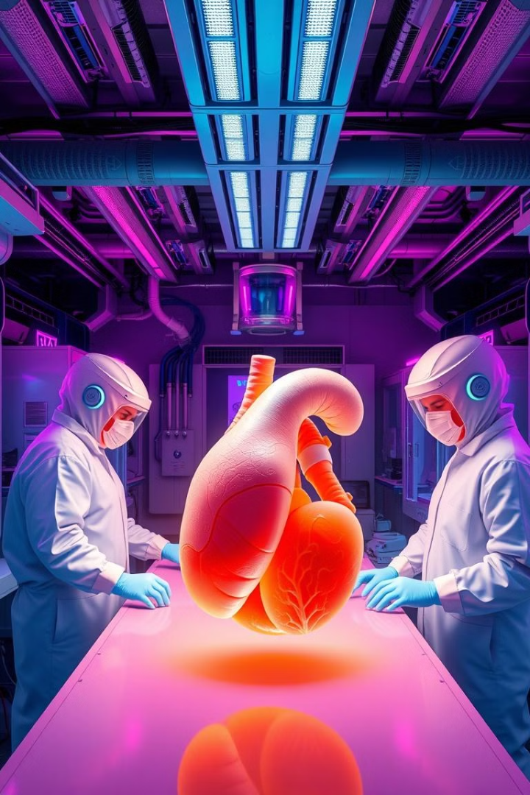
Bioprinting: Revolutionizing Medical Manufacturing
Bioprinting is a cutting-edge technology. It sits at the intersection of biology and engineering. It creates living tissue structures layer by layer. This can transform healthcare, research, and regenerative medicine.

Slide 2
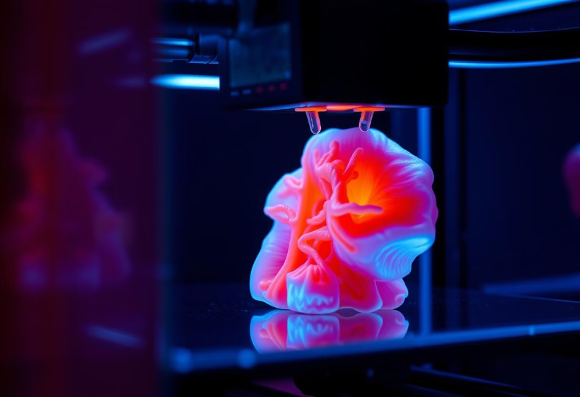
What is Bioprinting?
Bioprinting is an advanced 3D printing technique. It uses biological materials. It creates complex, living structures with cellular precision. It has applications in tissue engineering and drug testing.
Tissue engineering
Drug testing
Personalized treatments
Organ replacement

Slide 3
Types of Bioprinting Technologies
Extrusion-based
Droplet-based
Light-based
Bioink is pushed through a nozzle. It's the most common method.
Uses droplet-based printing. It allows high-speed, precise cell placement.
Uses photopolymerization or optical tweezers to precisely pattern cells and biomaterials.
Different bioprinting technologies have different strengths. Each is suited to specific applications and materials.

Slide 4
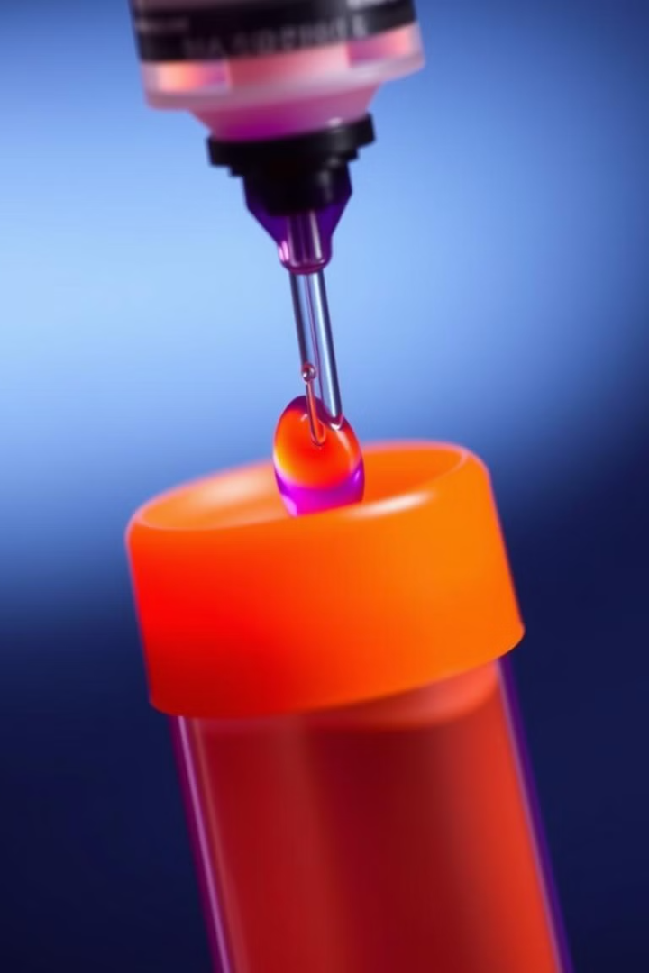
Understanding Bioinks
Specialized materials
Biocompatibility
Bioinks are used for 3D biological printing. They include living cells and hydrogel scaffolding.
Bioinks must be biocompatible. They must also be printable and support cell viability.
Structural Integrity
The bioinks provide structural integrity to the printed tissue. Growth factors are added for cell proliferation.

Slide 5
Challenges in Bioprinting
Cell Viability
Maintaining cell viability during printing.
Complex Structures
Creating complex vascular structures.
Scaling Up
Scaling up from small tissue samples.
Tissue Functionality
Ensuring long-term tissue functionality.

Slide 6
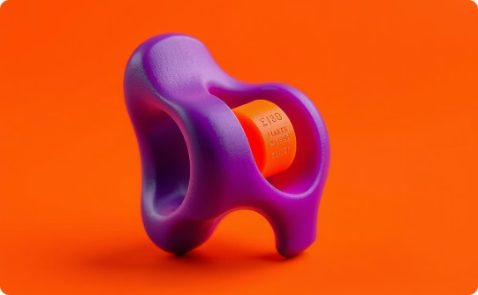
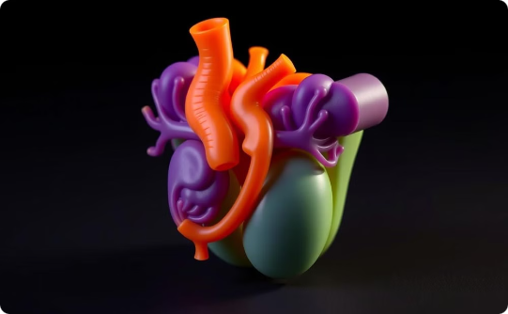
Current Medical Applications
Skin Grafts
Bone Reconstruction
Miniature Organs
Skin grafts for burn victims are available now.
Bone and cartilage tissue reconstruction are possible.
Miniature organ models are used for research.

Slide 7
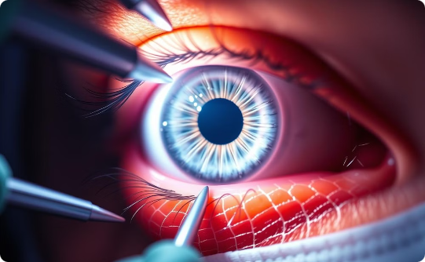
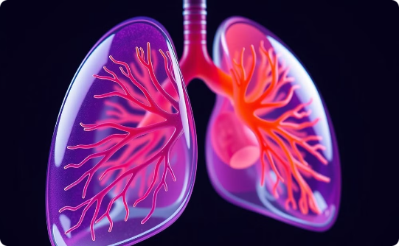
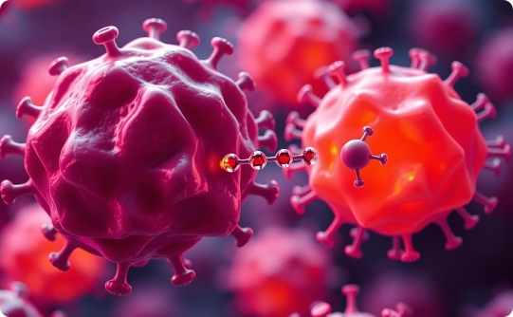
Current Medical Applications
Cornea Tissue
Lung Organ Printing
Cancer Modelling
Bioprinting offers a promising solution for corneal transplants, restoring vision with customized corneas.
Bioprinted lung models enable personalized and effective treatment approaches, aiding researchers in testing new therapies.
3D cancer models enable personalized treatments, helping test drug efficacy and accelerate the development of new cancer therapies.

Slide 8
Emerging Research Frontiers
4D bioprinting
4D bioprinting uses time-responsive materials.
Stem cell-based engineering
Stem cell-based tissue engineering is a key area.
Personalized medicine
Personalized medicine approaches are emerging.
Multiple cell types
Printing with multiple cell types is promising.
This presentation/images were created using Gamma AI.

